Slide 1


Getting Down to Business
Daniel.Smith@Ericsson.com
Sr. Developer
Cloud System - Architecture

Slide 2
Getting Down to Business
What is in Arno?
Fuel Deployment Demo?
Why is this important?
Eco-System and Evolution
Where do we go from here?

Slide 3
Getting Started – What is in ARNO?
GOAL: The goal of the ARNO release was to provide a baseline platform to enable the community to have a common platform(s) to begin their development work from.
  This includes providing a framework for:
    Continuous Integration
    Testing and Verification
    Feedback Loop to upstream providers for features/improvements

Slide 4
Breakdown of Arno:
Arno deliverables include:
  Build System:
    Using common tool set, we have created an environment that any contributor can add / modify / replace code to the project and have that code tested and verified within a pre-existing CI pipeline.
      Start Demo #1 – Load Patch for Lithium ODL into branch, merge and see CI system begin to Build and Test.
  VIM Installers:
    ARNO delivers two VIM installers. FOREMAN and FUEL. The focus for today will be on the FUEL deployment
    Within FUEL, we have introduced the following as well:
      DEA – Deployment Environment Adapters
      DHA – Deployment Hardware Adapters
      Puppet Injection method (pre-deploy.sh)
      Start Demo #2 – Login to a FUEL console, kick off a deployment (small deployment 1:1)
  CI Pipeline:
    Arno delivers an distributed CI pipeline:
      Multiple Community labs that enable the nightly testing and verification of additions / changes
      This allows for a broad coverage of different Datacenter Layouts and Hardware Combinations to be tested than a single DC could.

Slide 5
Arno Diagram
Openstack
Opendaylight
FUEL
FOREMAN
Upstream Installer Source
OPNFV ARNO Release

Slide 6
VIM Installers – FUEL Overview Demo
In this Demo, we will show the following:
  A sample FUEL GUI that is up and running
  Creation of a Deployment Environment
    Show off the OPNFV Puppet Module Inclusion Method
  Kick off the deployment of the ARNO release and let this run

Slide 7
BUILD SYSTEM / CI PIPELINE - DEMONSTRATION
On the following screen, we are doing to do some fun things:
In this demo, we will show the following:
  Pulling down the repo.
  Drop in the Lithium RC of ODL into the source code
  Commit our change and watch the Verify, Build and (maybe) Deploy get started
    <DASM – for the purpose of the demo, we wont wait for the build to finish, just show the Jenkins jobs picking it up and doing “Something” to a lab somewhere>

Slide 8
A little more about CI Pipeline / DEA / DHA
The goal of a CI Pipeline is to allow a “hands-off” verification of changes/commits to the master (we use single stream development).
  Since we have many different Hardware and Environment types, a “YAML Based” adapter for both has been setup.
  <DASM – Show and outlined the TWO YAML files>

Slide 9
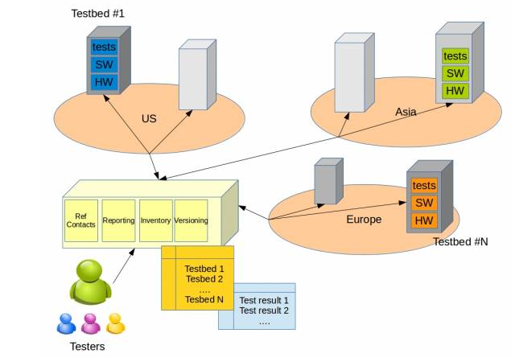
Distributed CI Pipeline
Code Change in Merged
Jenkins Verify Job Runs
*Multiple Projects
ISO Built
*Interval (now, nightly, etc)
Deployment
(Community Labs)
Validation/FT
Verification

Slide 10
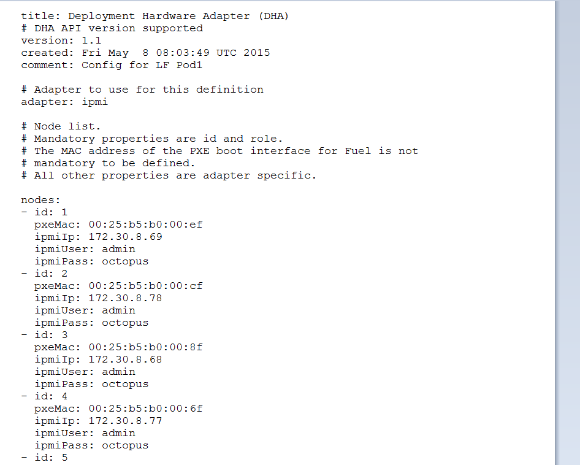
DHA YAML File Example
Simple YAML approach for IPMI Connections.
Support random Role to MAC assignment or Custom Install (node-id based)
Notes:
Allows for simple and portable definition of systems.

Slide 11
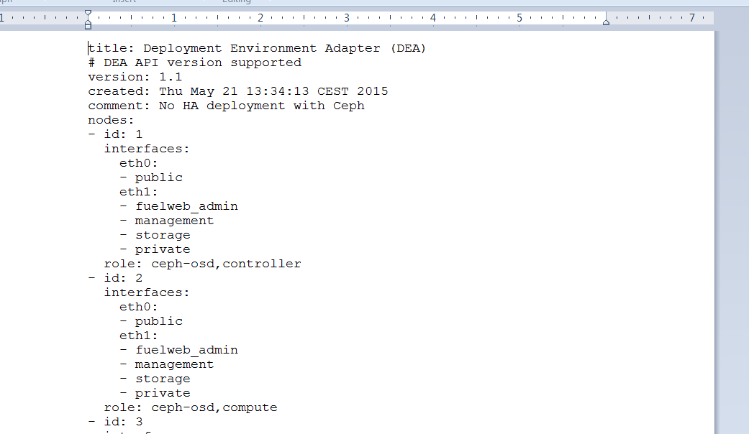
DEA YAML File Example
DEA Files allow for rapid re-deployment of various configurations (HA, Non-HA, Plugin Features, etc)

Slide 12
Eco-System / Evolution / Future
One of the stated goals of OPNFV is to provide a stream back to upstream providers to allow them to adopt or to change.
  Start Demo #3 – Show the startup of the ODL Container method in ARNO vs. Plugin Framework coming soon. (time permitting for menu)
Case Study:
  In Arno, we have post-build added the ODL container into the FUEL ISO and use a scripted to put things to together.
  Going forwards – we can see that coming from FUEL, they have created a “plugin framework” and added the ODL as a function that can be enabled during deployment
Notes:
Flip to other Screen
Login to a Deployment, start ODL – show GUI
Open another Link to 6.1 w/ Plugin
- Run command to install plugin rpm
- show GUI differences and explain.

Slide 13
Conclusion
We need you!
Integrators, Developers, Testers, we have a lot to get done and there is so much to learn!

